Slide 1


EMORI-HCM
Electromechanically Optimised Right Ventricular Pacing In Hypertrophic Cardiomyopathy
Jagdeep Singh Mohal
BHF Clinical Research Fellow
Supervisors:
Dr Zachary Whinnett (PI)
Dr Ahran Arnold
Dr Matthew Shun-Shin

Slide 2
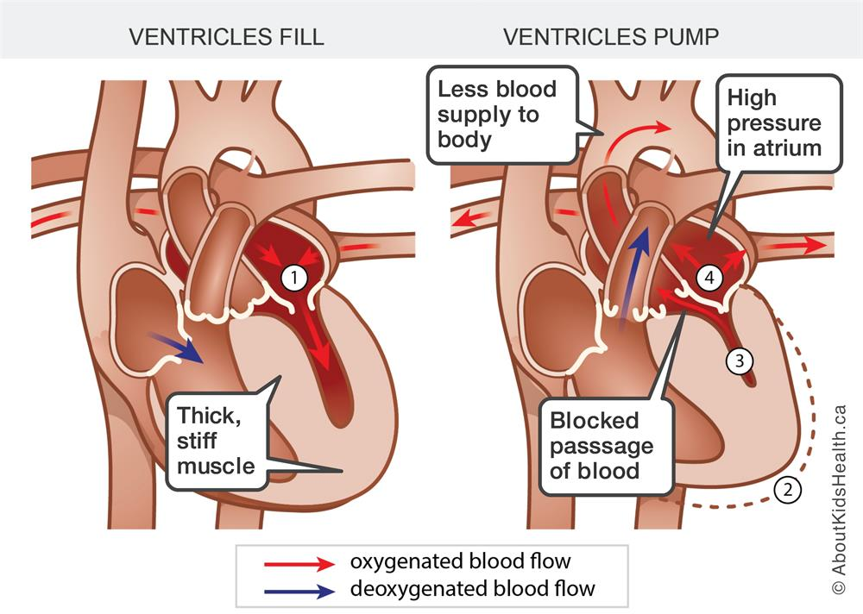
HCM Prevalence = 1/500
70% of HCM have LVOTO

Slide 3
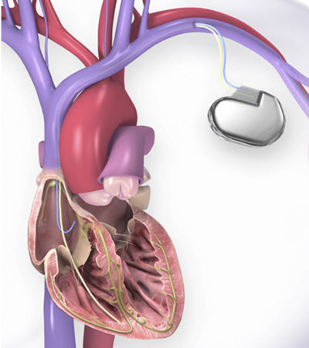
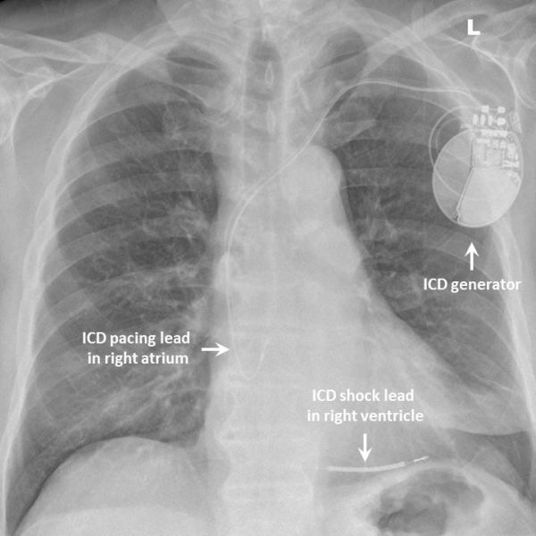
Patients with Hypertrophic Obstructive Cardiomyopathy (HOCM) experience debilitating symptoms including shortness of breath, blackouts and chest pain.
Current treatments are often poorly tolerated or ineffective – Beta Blocker & Disopyramide
Invasive alternatives include septal alcohol ablation, myectomy or heart transplant.
HCM patients often have an ICD implanted due to the increased risk of life threatening arrythmias.
ICD’s can also be used to deliver RV pacing (RVP) which has a role in treating patients with left ventricular outflow tract obstruction.

Slide 4
Has RVP been tried before?
Yes - however previous studies did not tailor therapies based on an understanding of the mechanisms of benefit and as a result the full potential of AVD optimised RVP has not been explored.
Some studies used:
- Shortest AV Delay
Longest AV Delay
AV Delay that bring the most LVOT gradient reduction
Previous trials also did not use high precision, reproducible haemodynamic methods to select AVD.
Did not look at the role of dyssynchrony and RV lead position.
The protocols typically also used small numbers of measurements with no assessment of whether the variation in measurements at different sites or AV delay could have been chance findings rather than persistent long-term differences.

Slide 5
Objectives
1. To use high precision techniques to identify what the optimum atrioventricular delay is to optimise the way the patient’s pacemaker functions. Use haemodynamic improvement as well as LVOT gradient change to guide choice of optimum AV delay.
2. To use high-precision techniques to assess the impact of dyssynchrony and how it affects blood pressure (surrogate for cardiac output) and LVOT gradient change.
3. To follow patients over a period of 6 months in a double blinded randomised crossover trial comparing:
Optimised AV Delay RV Pacing vs Minimum Ventricular Pacing

Slide 6
Primary Outcome:
1. Patient symptoms via The Kansas City Cardiomyopathy Questionnaire
Secondary Outcomes:
Patient symptoms via The EQ5D5L Questionnaire
Assessment of daily symptoms by completion of 2 questions via a daily symptom smartphone app
Change in exercise capacity by 6 Minute Walk Test & Cardiopulmonary Exercise Testing (MVO2)
Change in patient activity levels (based on data from device)
Change in BNP - Brain Natriuretic Peptide
Change in LV Ejection Fraction, resting and peak exertion LVOT gradients (Echo)

Slide 7
Inclusion Criteria
Clinical diagnosis of HOCM with an LVOT gradient of at least 30 mmHg, at rest or provoked.
Co-existing mid-cavity obstruction
Symptomatic
HOCM patients referred for Dual Chamber Pacemaker / ICD Implantation.
Ages 18 - 100 years old
Exclusion Criteria
Children age < 18 years or adults >100 years
Pregnant patients
Patients with persistent Atrial Fibrillation or high grade Atrio-Ventricular Block

Slide 8
REFERRAL PROCESS
1. Identification of HOCM Patients with LVOT gradient > 30mm Hg who already have a device (ICD / PPM) or are due to have a device implanted.
2. Referral to our research group at The National Heart & Lung Institute, Imperial College London
3. We will conduct a consultation with the patient regarding the study and to provide further patient information.
This study has obtained HRA Approval – Recruitment to start March 2022
The study is part of the Clinical Research Network – recruitment funding accrual available for referring centres.
For more information about the study or to discuss further please contact:
Dr Jagdeep Mohal
Clinical Research Fellow
j.mohal@imperial.ac.uk
Dr Zachary Whinnett – Principal Investigator
z.whinnett@imperial.ac.uk

